Slide 1
DocuMind – [Context-Aware Document Intelligence Conversational Agent] Building a Stateful RAG Chatbot with Django, LangGraph, and Groq
Presented by: MD Anas Mondol

Slide 2
The Problem & Solution
The Challenge: Organizations struggle to extract immediate value from static documents (PDFs, Manuals, Reports). Traditional search is keyword-based and lacks context.
The Solution: A secure, multi-user web platform where users can upload documents and engage in a natural language "brainstorming" session with their data.

Slide 3
Technology Stack
Backend Framework:
Django 4.0+ - Python Web Framework
Django REST Framework - API Endpoints
AI/ML Components:
LangGraph - Stateful Conversation Graphs
LangChain - Document Processing & Chains
Groq LLM - High-performance Inference
HuggingFace Embeddings - Text Vectorization
Data Storage:
ChromaDB - Vector Database
SQLite - Relational Dataase

Slide 4
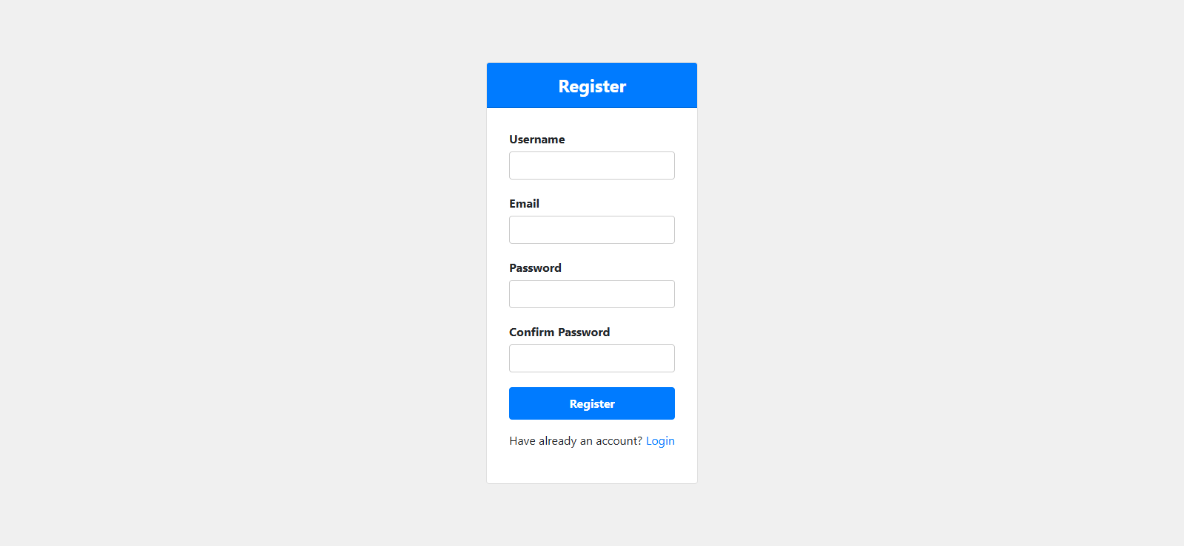
The Project Demo

Slide 5
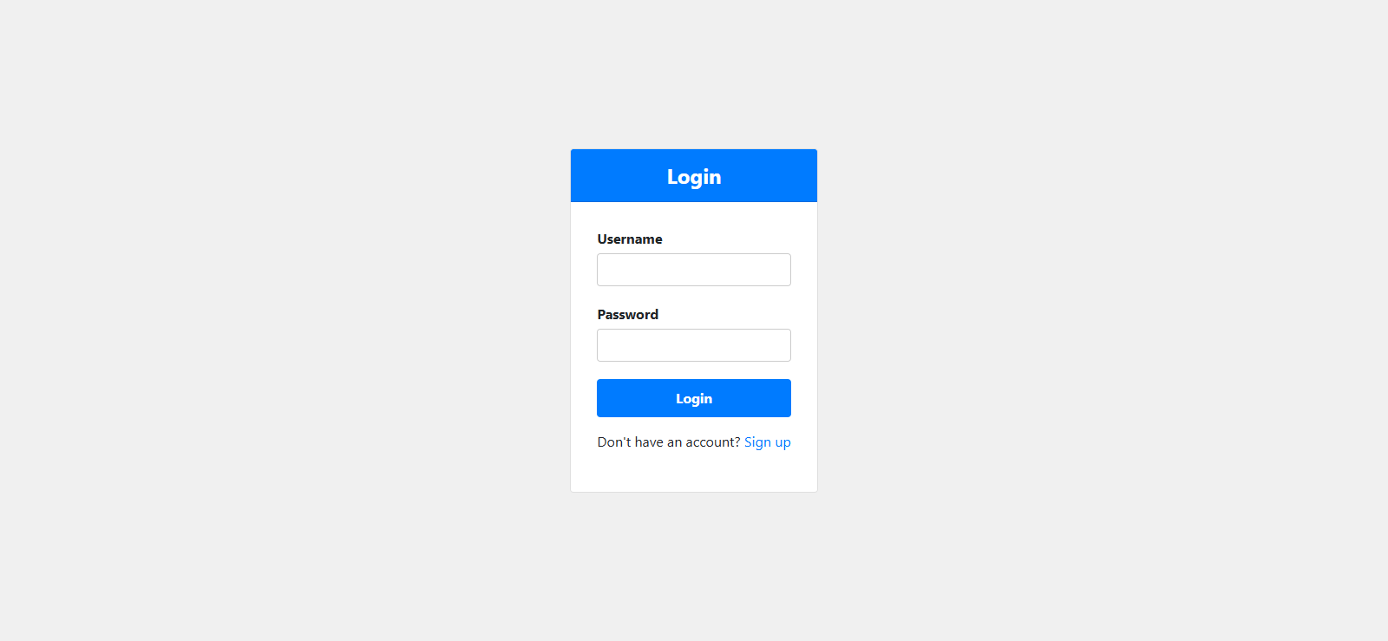
The Project Demo

Slide 6
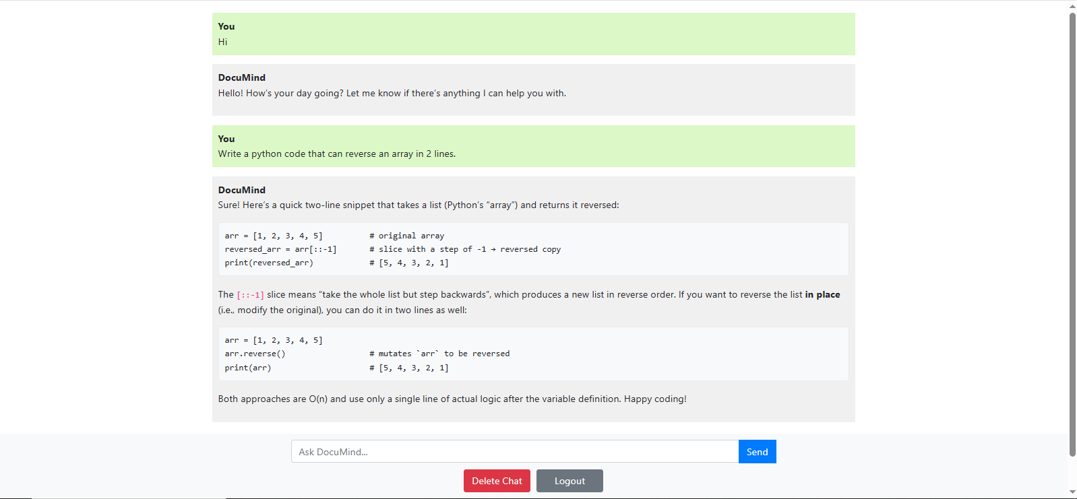
The Project Demo

Slide 7
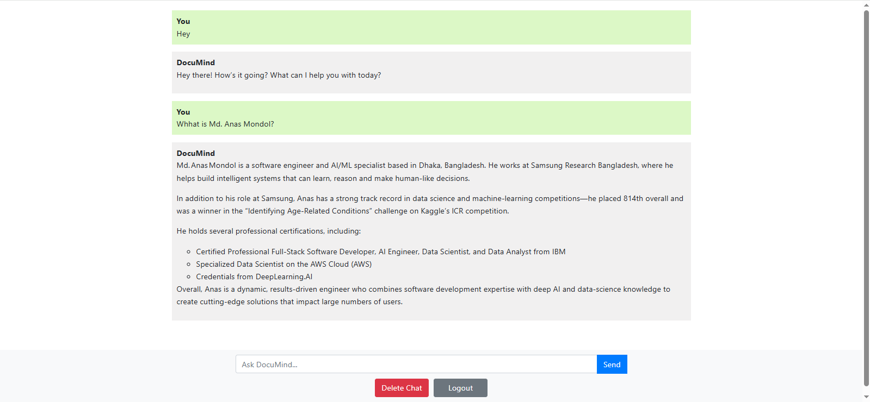
The Project Demo

Slide 8
Security Implementation
Authentication:
Django's built-in auth system
@login_required decorators
Session-based authentication
Password hashing & validation
Data Isolation:
User-specific vector store collections
Document access control by user ID
Chat history segmentation
Data Storage:
CSRF tokens on forms
@csrf_exempt only where needed
Secure cookie handling

Slide 9
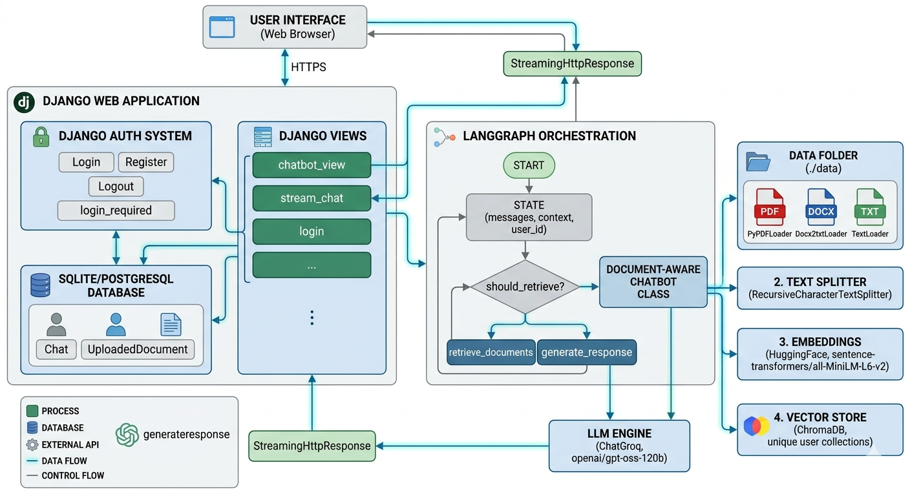
System Architecture

Slide 10
Technical Challenges & Solutions
Challenge 1: Vector Store Compatibility
→ Implemented fallback methods for different LangChain versions
Challenge 2: Document Loading Performance
→ Caching with doc_loaded tracking
→ Lazy loading only when needed
Challenge 3: Streaming Responses
→ Word-by-word streaming implementation
→ SSE (Server-Sent Events) pattern
Challenge 4: State Management
→ LangGraph's built-in state handling
→ TypedDict for type safety

Slide 11
Performance & Scalability
Document Processing:
Average processing time: 2-5 seconds per document
Chunk size: 1000 characters (optimal for retrieval)
Query Response:
Retrieval time: < 200ms
LLM inference: 1-3 seconds
Streaming latency: 50-100ms per chunk
Scalability Features:
User-isolated vector stores
Lazy document loading
Connection pooling for database

Slide 12
Future Roadmap
Automated Document OCR: Integrating AWS Textract for scanned images.
Source Citations: Adding metadata pointers to tell users exactly which page/file a fact came from.
Advanced Agents: Adding a "Web Search" tool node to LangGraph for queries outside the document scope.

Slide 13
More Details about the Project
Please, visit the following links:
https://github.com/Anas436/Chatbot

Slide 14


